Slide 1
Microsoft Dynamics CRM 2011 Walkthrough
Part 1: End-user tools and features
Jukka Niiranen
http://niiranen.eu/crm

Slide 2
Table of contents
Walktrough Part 1
Walktrough Part 2
End-user tools and UI enhancements
Outlook client
Form customization options
Auditing
Connections
SharePoint integration
Visualizations
Goals
Customization menus
UI customization options
Solution management
Web resources
Processes (workflows)
Custom activities
Queue enhancements
Multiple forms per entity
Security features

Slide 3
End-user tools and UI enhancements

Slide 4
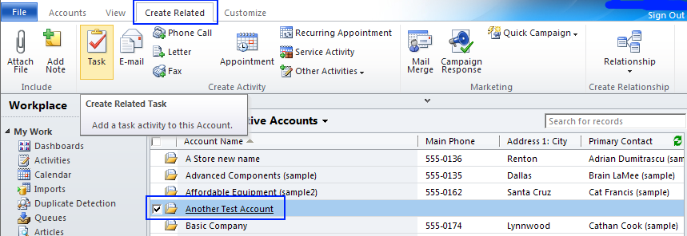
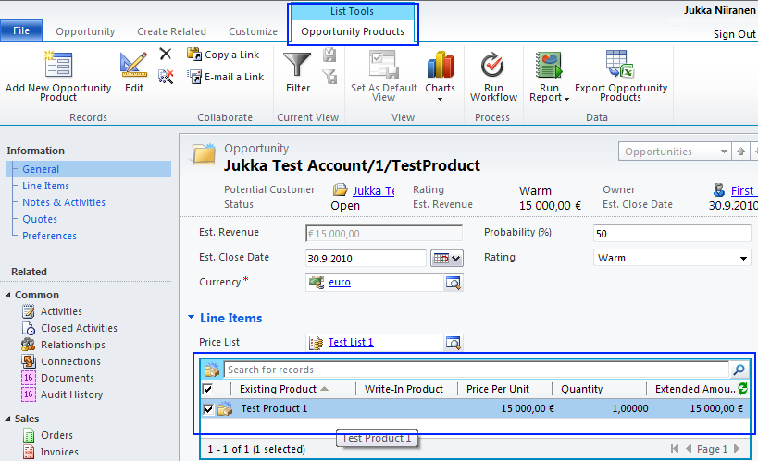
Context-sensitive ribbon
Create related records
Show list tools for subgrids

Slide 5
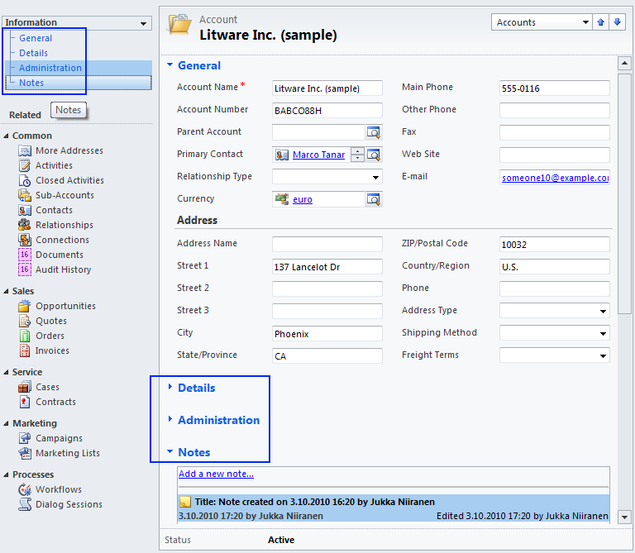
Form sections instead of tabs
Links to section anchors
Collapsable sections
Persistent header and footer fields

Slide 6
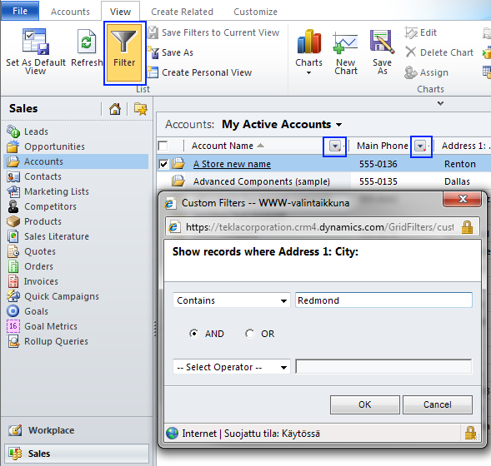
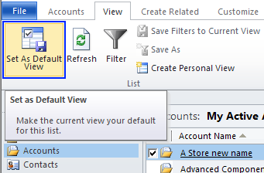
Filters and default views
Filter based on view column contents
Set personal default views

Slide 7
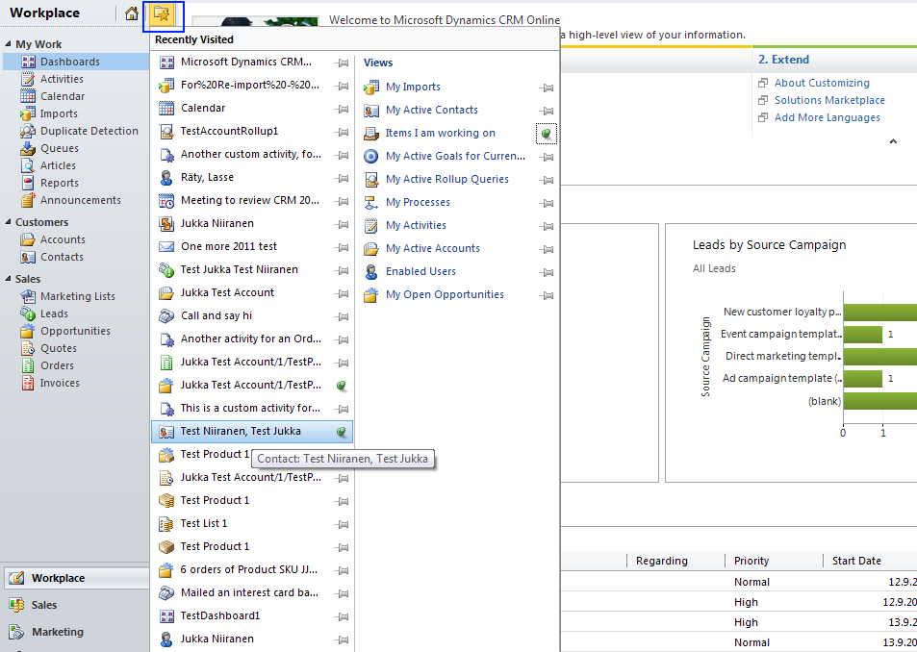
Recently visited records & views
Pin items to recently visited records menu

Slide 8
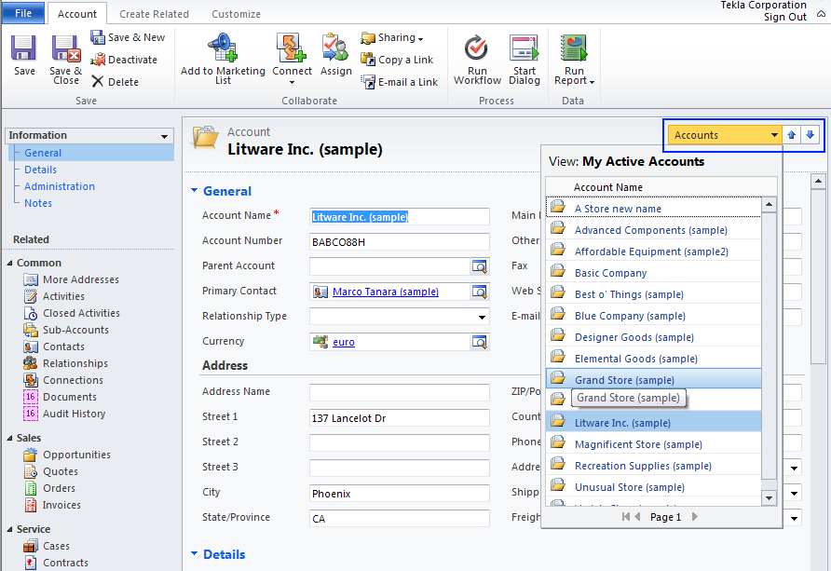
Browse records on detail form
Scroll through records and views on any form

Slide 9
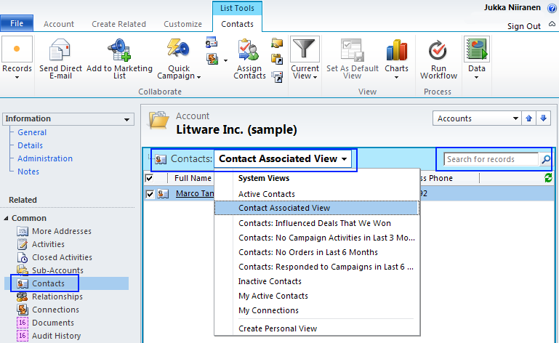
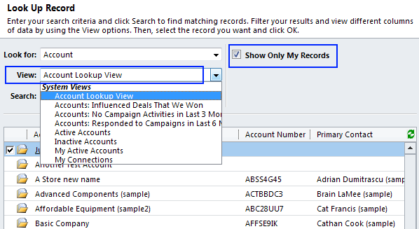
View options
Full view selection controls in associated views
Enhanced view controls in lookup dialogs

Slide 10
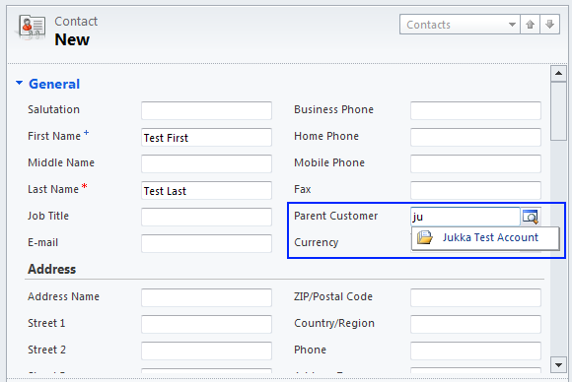
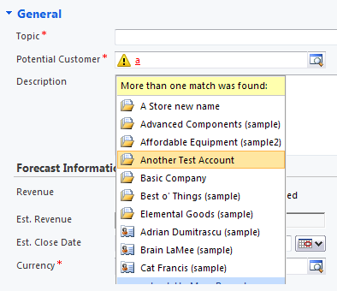
No more form assistant pane
Smart lookup fields have replaced form assistant pane
Form options for auto-resove and most recently used items

Slide 11
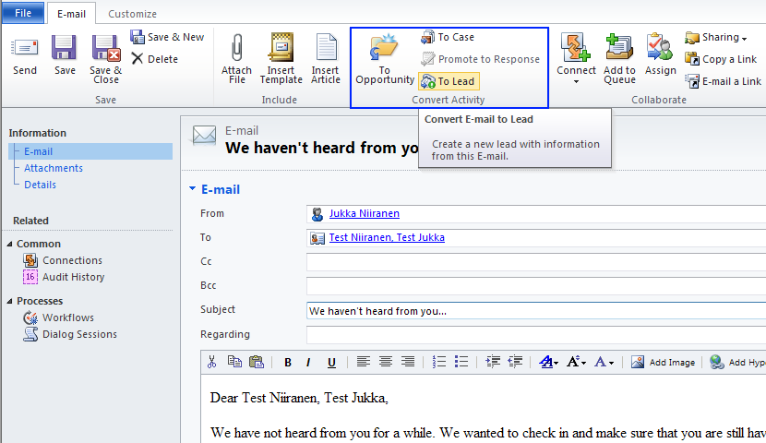
Convert emails (1)
Create a new lead, opportunity or case directly from the email activity ribbon

Slide 12
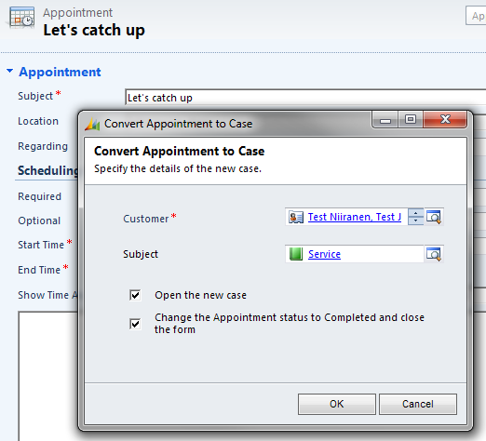
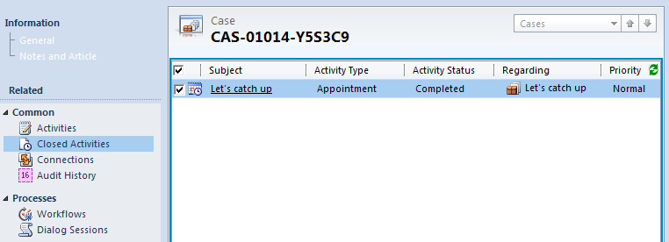
Convert emails (2)
Dialog window requests details
Activity history is recorded under parent record

Slide 13
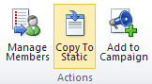
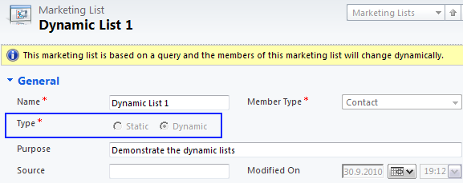
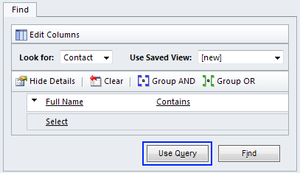
Dynamic Marketing Lists
Lists can be made static (traditional) or dynamic
Dynamic list’s members will be automatically updated based on a stored query criteria
However, list membership is only shown for static lists under the member record’s related marketing lists view

Slide 14
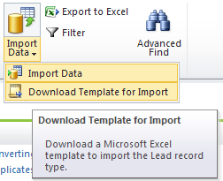
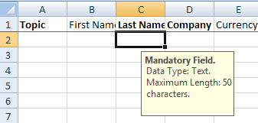
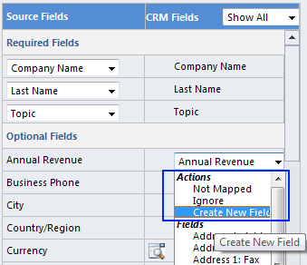
Data import wizard
Download example templates of entity field lists and formats
Create new entities or fields directly through the import based on source data mappign
There will be no separate Data Migration Manager for CRM 2011
See blog post from PowerObjects for more details: http://www.powerobjects.com/blog/2010/10/01/crm-2011-data-import-wizard/

Slide 15
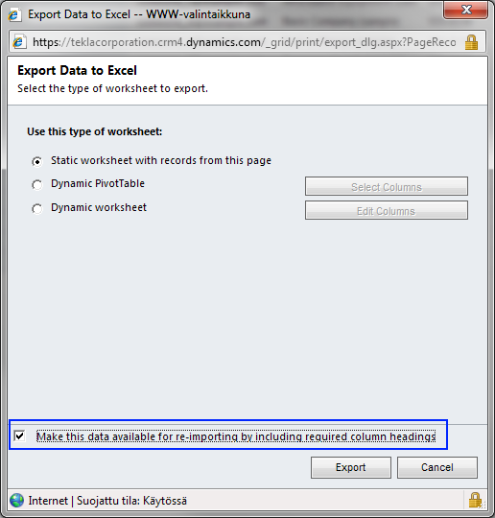
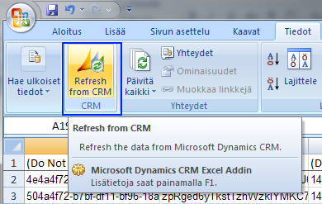
Excel data export & re-import (1)
Refresh Excel records of static worksheets with CRM data
Link exported data to CRM records with GUIDs

Slide 16
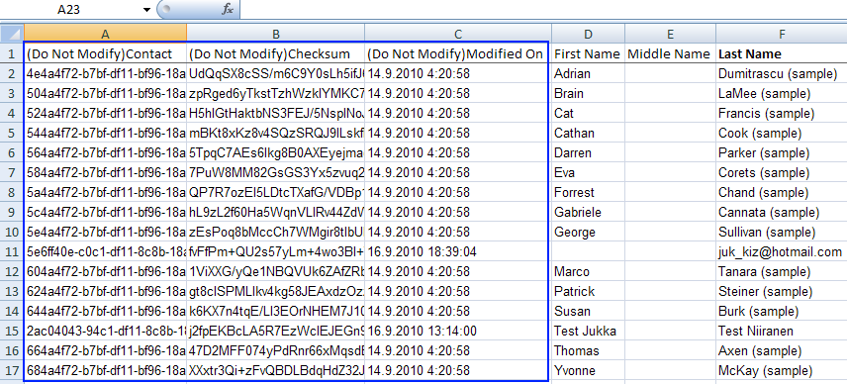
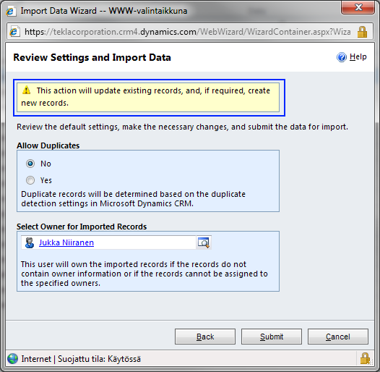
Excel data export & re-import (2)
Import data to update existing records or create new ones

Slide 17
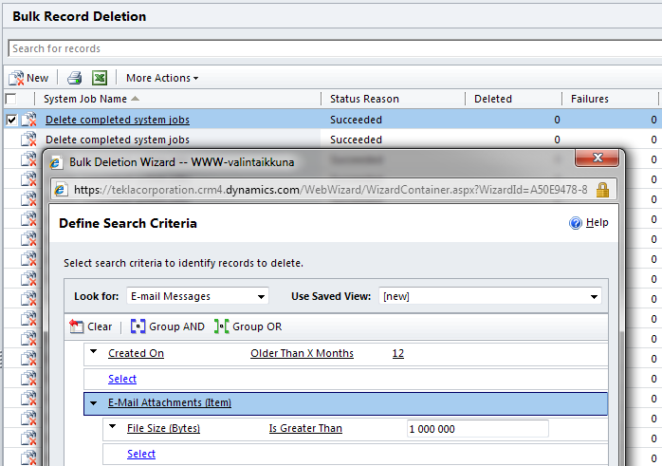
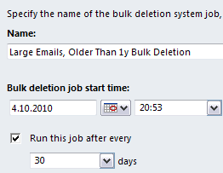
Bulk deletion wizard
Delete records in bulk based on AF criteria
Schedule deletion jobs to run every X days

Slide 18
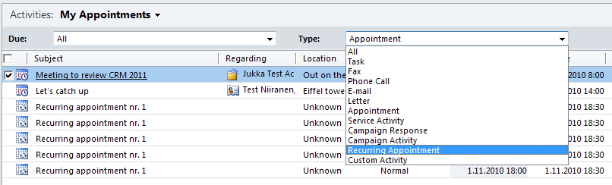
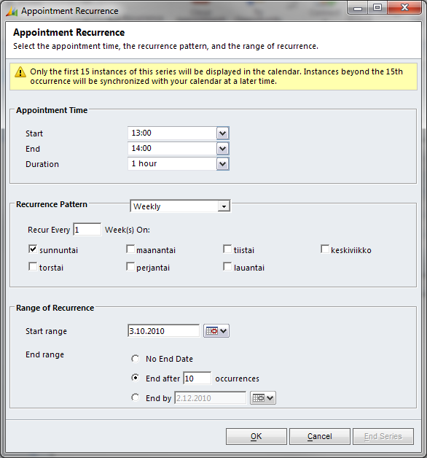
Recurring appointments
New activity type provided for recurring appointments

Slide 19
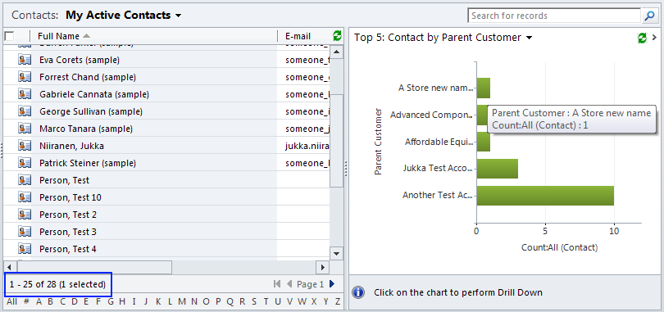
Total counts in grids
Total count of records in the view is displayed below the grid
…but page count is not

Slide 20
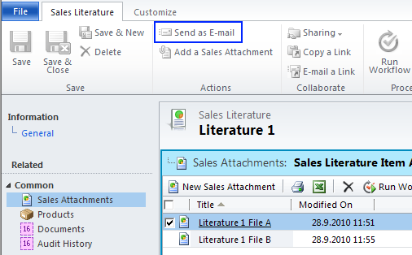
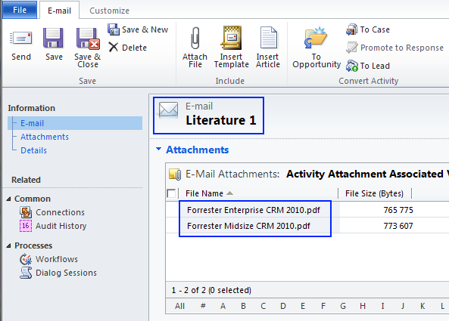
Sales Literature emailing
Attach a package of files to email through Sales Literature

Slide 21
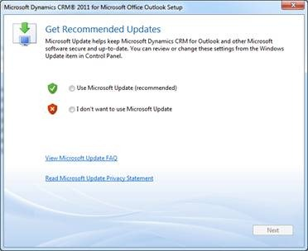
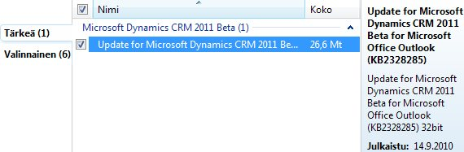
Windows Update support
Client updates to CRM 2011 will be distributed through Windows Update
WSUS (Windows Server Update Service) to be also supported after RTM

Slide 22
Outlook Client

Slide 23
Highlights
New Outlook client built from ground up to work with Outlook MAPI (Microsoft’s Messaging API)
Provides native Outlook controls to activities and also other CRM records
Contains additional view configuration and data browsing features not available through the CRM web client
CRM application menu structure integrated into Outlook UI more tightly (requires Office 2010)

Slide 24
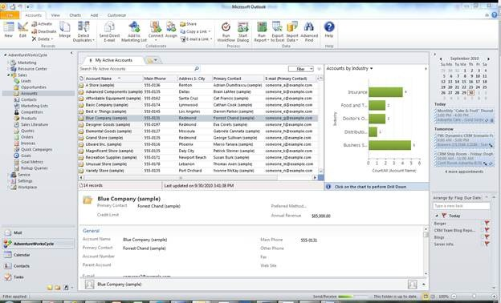
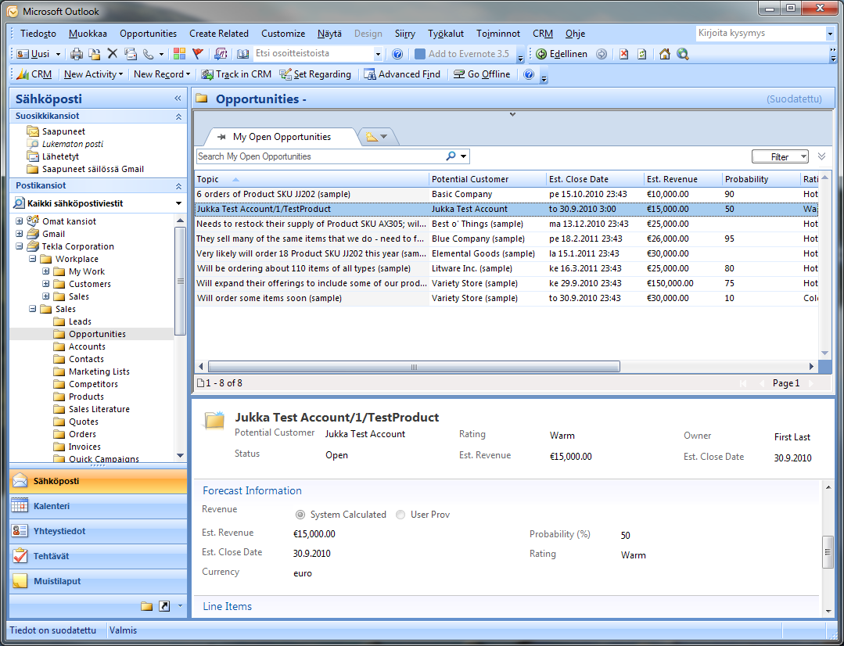
Outlook 2010 vs. 2007/2003
Ribbon converted to menus in 2007/2003
Ribbons are converted to menus in 2007/2003
Navigation panes and graphic folders only in 2010
Navigation panes and graphic folders only in 2010

Slide 25
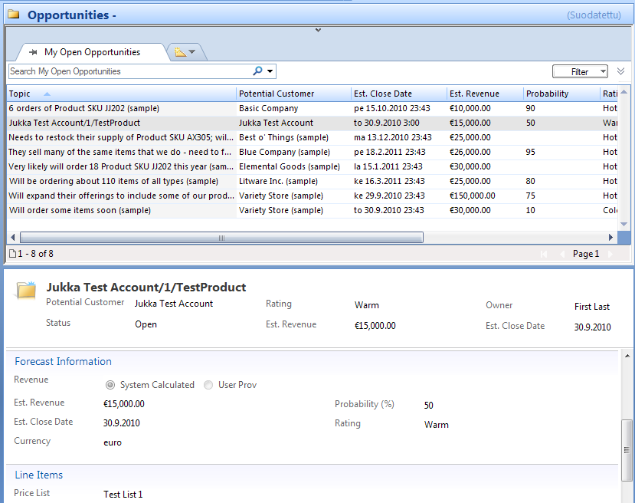
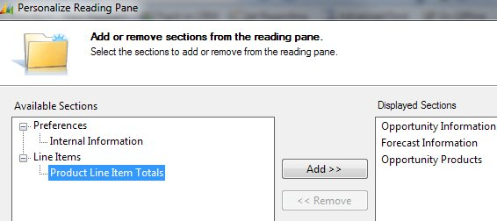
Reading panes
Scrolling through records in grid allows ”inbox style” navigation through CRM data
Reading pane displays detail data, form section contents can be personalized

Slide 26
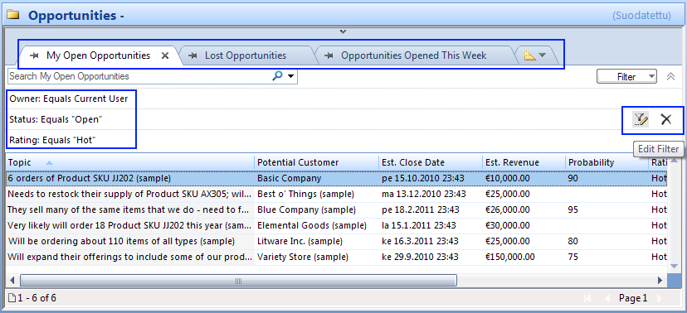
View tabs and filters
Multiple views can be opened on tabs for quick data comparison
Custom filters can easily be applied to existing views

Slide 27
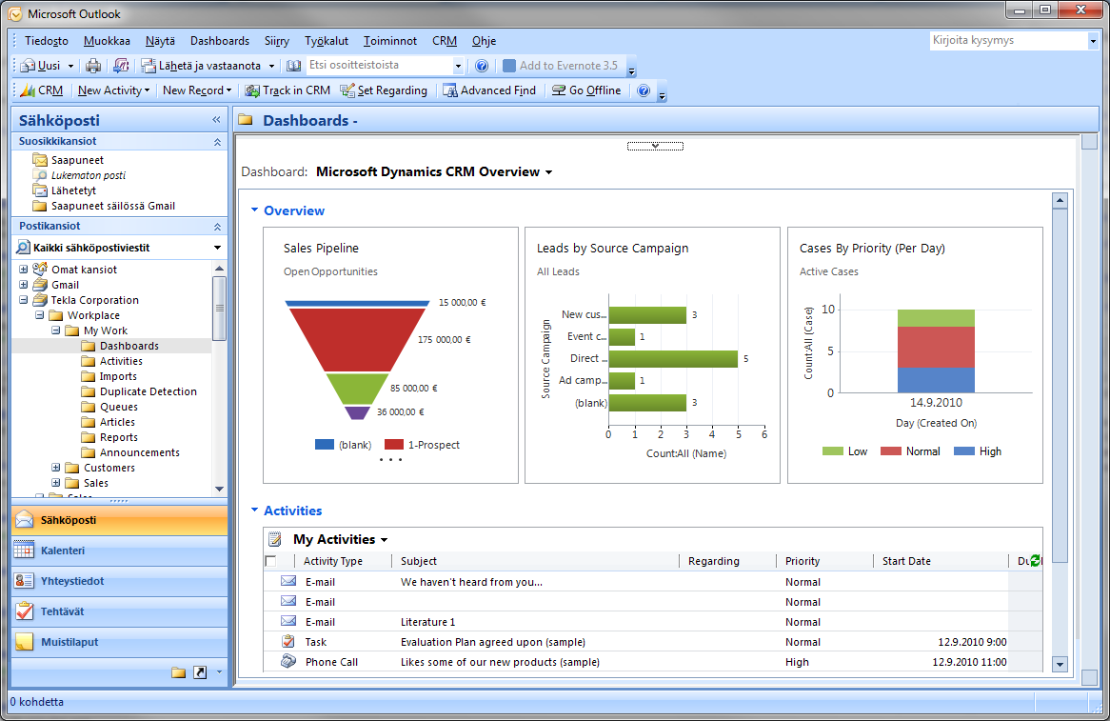
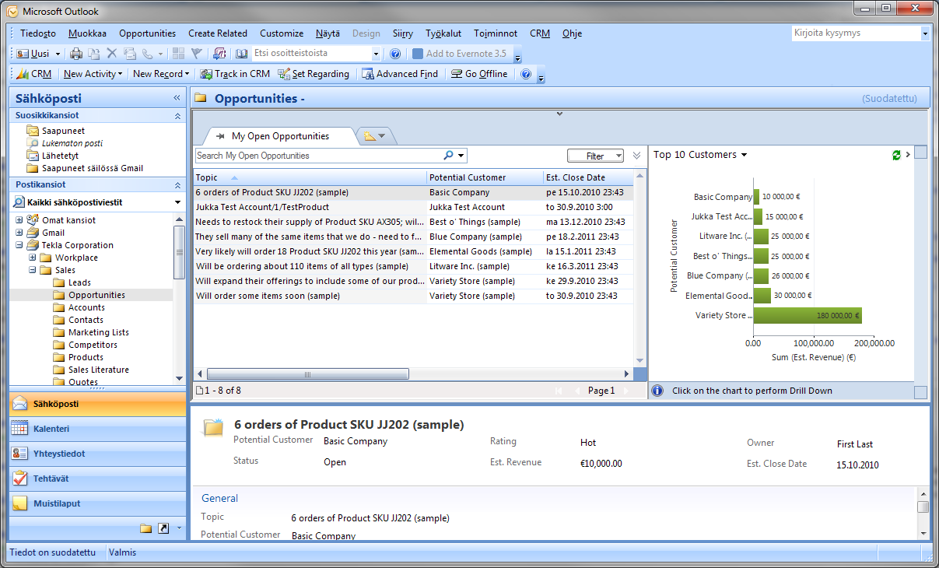
Full visualizations support

Slide 28
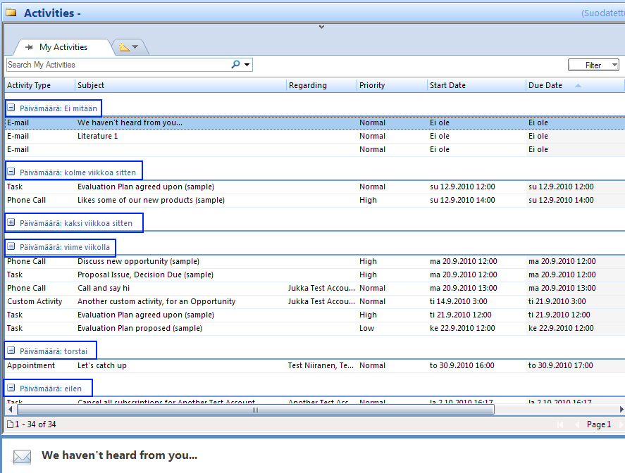
Activity grouping
Native Outlook grouping options for activities (by due date etc.)

Slide 29
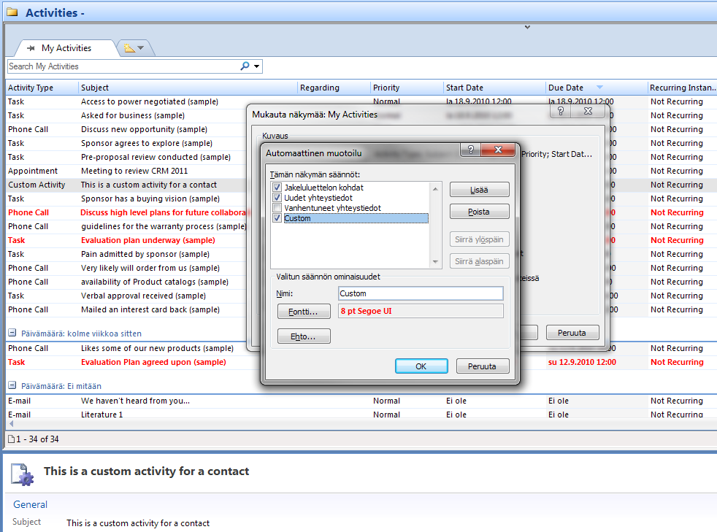
Conditional formating
Create custom format rules based on field data conditions

Slide 30
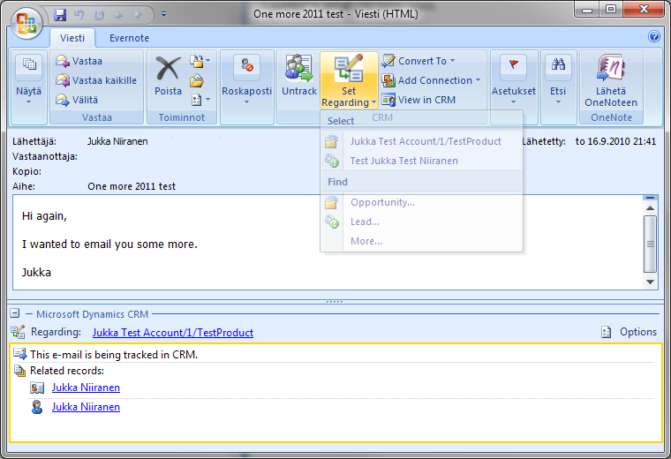
Regarding records
Regarding pane displays links to related records

Slide 31
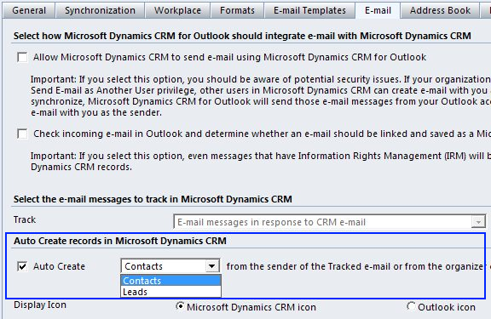
Auto create contacts or leads
Outlook settings can be configured to create new records for sender of an email tracked to CRM

Slide 32
Multi-tenancy
Single Outlook client can be used for opening multiple CRM organizations
Organizations displayed as menus (Outlook 2010) or folders (Outlook 2003/2007)
However, activity tracking is only possible with one organization per client

Slide 33
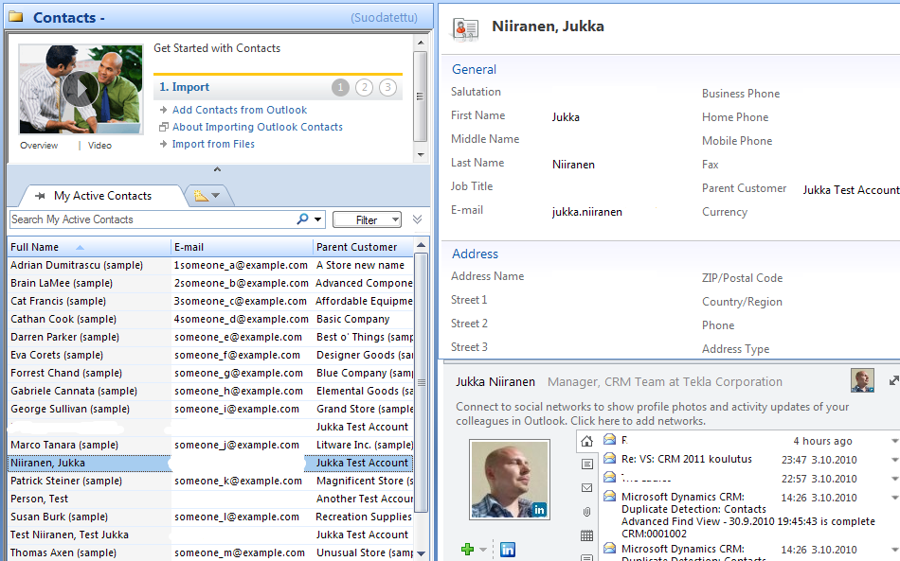
Outlook Social Connector
Social network profiles and streams can be integrated into the contact reading pane

Slide 34
Form Customization Options

Slide 35
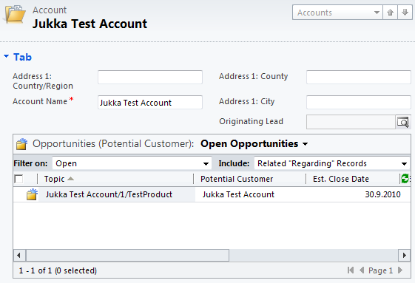
Sub-grids
Add related child entity grids on parent entity view through form customization (no more iFrames)
Control default views and UI features displayed

Slide 36
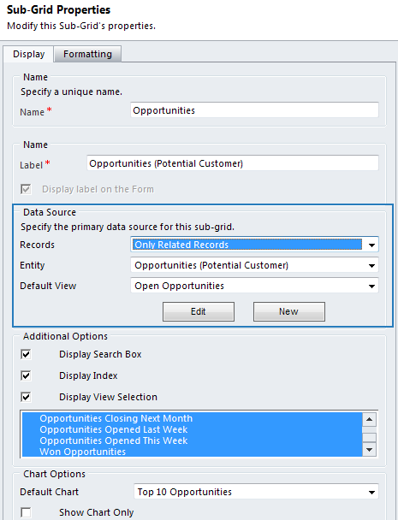
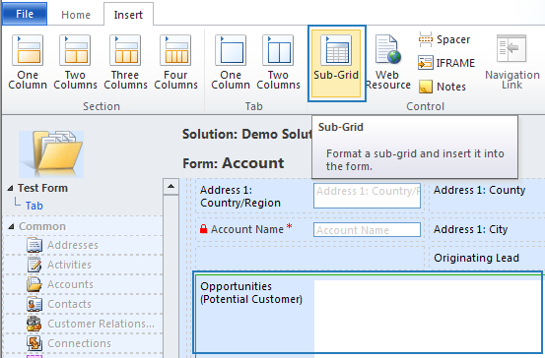
Adding a sub-grid on the form

Slide 37
Filtered lookups
Form customization options include ability to show records based on simple query criteria
Common scenario: show only accounts where the parent account is equal to current account
Lookup controls are programmable, i.e. can be modified through SDK when GUI is not enough

Slide 38
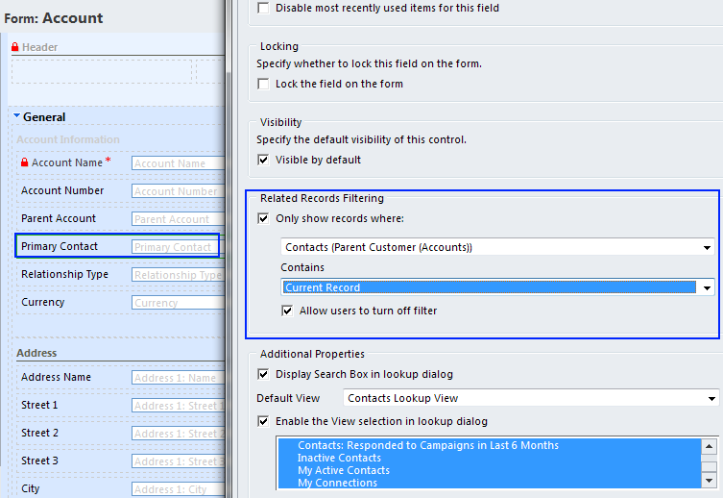
Related records filtering

Slide 39
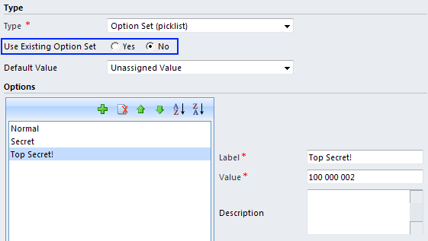

Option sets
Option sets = global picklists
Re-usable lists of values that can be shared across different entities
Values can be populated/maintained through SDK

Slide 40
Auditing

Slide 41

Auditing features
Available on common entities as well as custom entities
Auditing data is recorded across a designated period of time in partitions (audit logs), which can be deleted from the Settings menu
From Microsoft Dynamics CRM 2011 Beta SDK

Slide 42



Enabling auditing
System level
Per field
Per entity

Slide 43

View audit history per record

Slide 44


Audit summary view

Slide 45

Audit data security
Privileges are defined on system level, not per entity or field
Complete audit summary can be hidden from normal system users

Slide 46
Limitations
Audit data is not available in Advanced Find queries, nor for reporting
FilteredAudit view does not surface all relevant fields from the tables
Audit records and record details can be retrieved through SDK
Some system fields do not allow changing auditing settings other than on per entity level

Slide 47
Connections

Slide 48
Connections vs. Relationships
Replaces the Customer Relationships feature that was limited to accounts, contacts and opportunities
Connections can be formed between any entity (default and custom)
However, the old Relationship remains in the schema for backward compatibility purposes
Default security roles will not even show the Relationship data to normal users, but of course admins will have them in the UI
Relationships will be deprecated in future CRM versions, data should be migrated to Connections

Slide 49


Quick-create a Connection
Shortcut on the ribbon: ”Connect to me”
Collapsed form with minimum fields

Slide 50


Relationship roles
Role data is stored on the solution, i.e. records are portable
Unlike Relationship roles, new Connection roles can be created by a user

Slide 51
SharePoint Integration

Slide 52
Features
Integration to Document Library functionality only
Supports MOSS2007 and SP2010
iFrame & default chrome in MOSS2007
Automatic folder creation
Folder naming: Account, contact or custom entity
Required the list component, which is only available for SP2010
Documents can be attached to multiple locations
However, automatic folders support only one location
Entities can be enabled for SharePoint integration in configuration

Slide 53

SharePoint List Component
See blog post by Mark Kovalcson on the component installation process:
http://crmscape.blogspot.com/2010/09/ms-crm-2011-sharepoint-list-component.html

Slide 54


Document management settings
Select entities to be enabled for Document Management
Define folder structure to be used in path names

Slide 55
No security integration
CRM and SharePoint security settings are no synchronized in any way
User rights to the CRM record and the SharePoint site where documents are stored will have to be managed independently from one another
Especially with MOSS2007, the iFrame wil allow users to navigate to any site/library, so UI cannot be utilized as a ”soft” security measure

Slide 56
CRM data in SharePoint
BDC was not included in WSS 3.0, whereas BCS (Business Connectivity Services) is included in the new SharePoint Foundations
With the help of Search Server Express 2010 this will allow building ”Goolge style” global freetext search for CRM data
Note: SP2010 uses .NET 3.5, while CRM 2011 is built on .NET 4

Slide 57
Visualizations

Slide 58
Charts and grids
CRM visualizations are attached to entities
Default visualizations = charts with GUI editor
Also Web Resources can be used as visualization components through SDK
Charts are integrated with grids, displaying the same data that is defined in the view query criteria
Drilling down on a chart updates the grid, filtering the grid updates the chart

Slide 59

Chart controls
Built on Microsoft Chart Controls for .NET Framework 3.5
Included types out-of-the-box: column, bar, line, pie, funnel
CRM supports single-series and multi-series charts, but not multi-category
See http://code.msdn.microsoft.com/mschart for sample downloads on MS Chart Controls for .NET 3.5

Slide 60

Viewing charts on grids
Editing controls are under the View tab
Existing charts can be pulled from right side of the grid

Slide 61


Drilling down
Click on chart data to start drilling down
Drill levels displayed in breadcrumb navigation

Slide 62

Creating new personal charts
Define chart type
Select fields and values

Slide 63

Creating new system charts
Defined in entity customizations, included as a solution file component
Note: view selection setting is for preview only, as charts consume data from the views the user selects

Slide 64



Custom charts
Chart definitions can be exported and imported
Query criteria can be modified using FetchXML to retrieve data not allowed by the simplified chart designer
Also presentation can be modified with parameters in the XML

Slide 65

Dashboards
Collections of visualization components that can be built and configured by the CRM end-user
Supported content types: charts, grids, iFrames, web resources (html, scripts, Silverlight…)

Slide 66

Creating a new dashboard (1)
Select from predefined layout options

Slide 67

Creating a new dashboard (2)
Adjust component size on the form
Add components on the dashboard
Modify tab and section titles

Slide 68

Creating a new dashboard (3)
Configure data sources for charts
Configure options visible on the dashboard
Configure chart type

Slide 69
Goals

Slide 70
Features
Goal management: set targets, measure results
Track actual, in-progress or custom data
Hierarchies:
Parent and child goals
Roll up goal totals to parent
Goal manager has editing rights, Goal owner can only read and append
Connected to CRM fiscal period or custom period

Slide 71
Goal data structure
Goal: target figures
”X qualified web leads in period Y”
Goal Metric: target data type (amount or count)
”Lead records, by status, per creation date”
Rollup Query: record set to calculate the metric from
”All leads where source = web”

Slide 72


Goals and goal metrics records

Slide 73
To be continued in part 2…

Slide 74


Follow my #MSDYNCRM tweets on http://twitter.com/jukkan
Subscribe to by blog:
Surviving CRM http://niiranen.eu/crm

